Slide 1
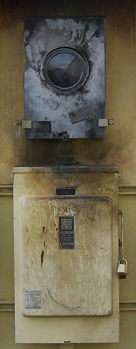
Two Brief
Teaching
Cases
James Merlo, NERC
& Jake Mazulewicz,
Dominion VA Power
__________________________
NERC Human Performance Conference
March 2013
©2013. Dominion. All rights reserved.
Notes:
Thanks to the many dedicated professionals (and their bosses) who contributed anonymously to this presentation. Without their trust, honesty and willingness to share, we would have far fewer lessons to learn from. Thank you!
_________________________
Hi,
Interactive teaching cases like these have been a game-changer for many companies.
I know of no better method for consistently improving employee engagement during training.
This set of two-related teaching cases is best presented as a dialogue between TWO presenters.
James Merlo and I modeled this presentation style on purpose at the NERC conference.
This presentation is designed only for educational use by trainers working within electric utility companies. It’s NOT designed for commercial use. Questions? Please email jake.j.mazulewicz@dom.com or contact Dominion Virginia Power Safety & Training at 804-751-3016.
This “Notes” section on each slide contains far more details about each case than you would ever reveal to the audience.
Good luck teaching!
To prepare to teach these two cases
Print out the slides with teaching notes visible on each page.
Instead of just “reading through” the technical details, try this. Find a colleague who you trust, sit down with them for 20-30 minutes and “talk” through” one entire case with them.
Instead of just reciting the teaching notes, tell the story in your own words.
“Talk through” this case 3-5 times until your version of the story is credible, coherent and clear to you and your test audience.
Ensure your co-presenter does the same.
Finally, practice presenting WITH your co-presenter to plan your dialogue and estimate your time hacks. (James and I did the first case with reasonable audience interaction in about 30 minutes. Please feel free to adjust that for your style and your audience.)
Best,
Jake Mazulewicz
Richmond, Virginia
March 2013

Slide 2
Could this happen
at my company?
These case studies are intended only to foster thoughtful discussion and may not show correct technical procedures. Consult your official resources and your Supervisor for correct policies and procedures. Names and details in this case may have been changed and may not represent any one actual event.
Notes:
You might be tempted to ask, “Did these events happen at someone’s company?”
The smarter question to ask is, “COULD this event happen at my company?”
We hope you’ll agree the answer is “Yes.”
________________
Duration = 15 secs
Total Elapsed = 1 min
________________
Summary of Case (FYI only. Do NOT share all this with audience at this point
During this investigation we asked the injured employee why he did not install the clear, dead-front, safety shield in the meter adapter prior to setting the meter? (The shield will not allow a misalignment) His response was he did not know that the “clear piece of plastic” was a required safety device. He thought it’s use was optional. He stated that it was easier to install the meters if the clear piece was not used and had been setting these meters for a couple of years without the shield. This surprised the investigators due to the fact that this was a very knowledgeable and safe employee who had no history of incidents. The committee decided to question other servicemen throughout the organization to get their input and they conveyed the same opinions and understandings as the injured. We also determined through the investigation that of the approximate 100 meter adapter devices on the servicemen’s trucks, about 50% of them did not even have a safety shield available. When taken out of the shipping box…, they were
being trashed! Upon further discussions, it was determined that the protective shield was not mentioned or described as a safety feature in our meter training classes. The instructors told us that they did not specifically tell the students that the shield “had to be in place.” They thought it would be obvious! Lesson Learned: Only after I started in my new role in Human Performance and was introduced to the “Culpability Matrix,” did I realize that we had performed the “Substitution Test.” Would other employees with similar training and experience have made the same mistake? If the answer is yes…, start looking for organizational weakness.

Slide 3
The First Event
Notes:
Presenter 1:
On a Monday morning in June while back, a Distribution Electric Serviceman was assigned the task of disconnecting service to three customers at a local shopping mall. This work involved removing the existing meters, installing a disconnect adapter at each location, and them re-installing the meters. As the Serviceman was re-installing the second meter, a flash occurred. The injured employee was transported to the hospital and admitted for treatment.
All three of the meters were grouped together at the same location. The customer serviceman decided to remove all three meters, install the three disconnect adapters, and then re-install each of the meters. The disconnect adapter allows the meter to remain energized after re-installation but does not allow current to flow through the meter.
The three meters were removed from the meter bases. A disconnect adapter was placed in the first meter base. The second meter base was configured in a manner that required the removal of one of the blade assemblies from the disconnect adapter.
________________
Duration = 45 secs
Total Elapsed = 2 mins
(all time hacks approximate)

Slide 4
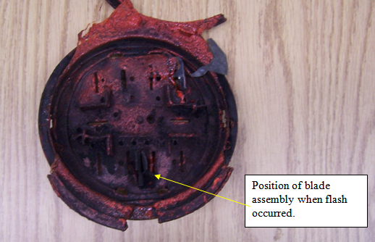
The Cause
Notes:
Presenter 1:
The disconnect adapter is design to allow the blade assemblies to be rearranged or removed to accommodate different meter blade configurations.
In order to remove the blade assembly from the disconnect adapter, a dead-front safety shield had to be removed.
With both the dead-front safety shield and the blade assembly removed, the disconnect adapter was installed in the second meter base. A disconnect adapter was also installed in the third meter base.
The removal of a blade assembly was not necessary on the first and third disconnect adapter. The first meter was re-installed without incident.
When attempting to re-install the second meter, a flash occurred. Following the flash, the injured serviceman called his supervisor to inform him of the incident and a member of the shopping mall’s management dialed 911.
The customer serviceman stated that he had routinely used this type of disconnect adapter during the last three years.
The meters that were being removed and re-installed were three-phase, 277/480 volt, self-contained watt-hour meters.
All of the meter bases were, three-phase, 600 volt, with a lever bypass feature.
________________
Duration = 30-45 secs
Total Elapsed = 3 mins
(all time hacks approximate)

Slide 5
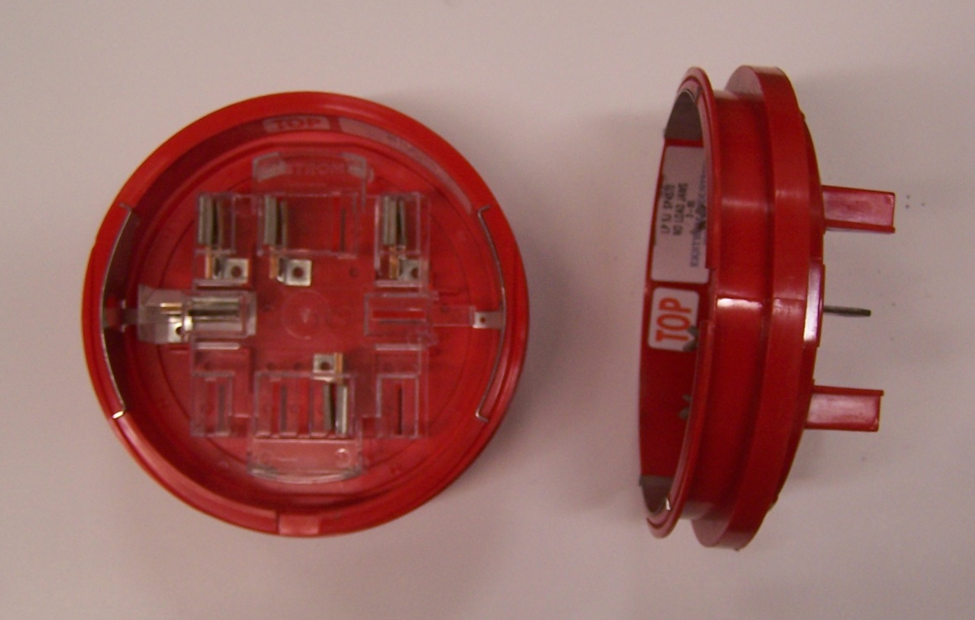
The Cause
Notes:
Presenter 1:
________________
Duration = 30-45 secs
Total Elapsed = 4 mins
(all time hacks approximate)

Slide 6
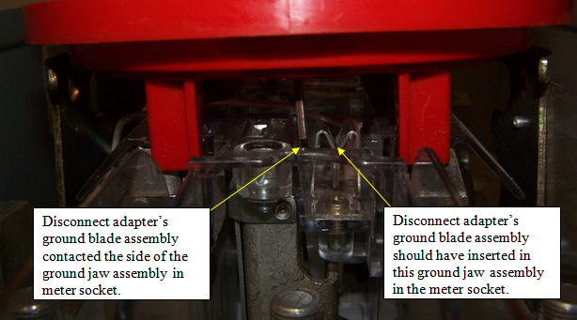
The Cause
Notes:
Presenter 1:
The disconnect adapter’s ground blade assembly was not positioned correctly to connect to the grounding jaw assembly of the meter base.
The dead-front safety shield was not re-installed in the disconnect adapter prior to resetting the meter.
The serviceman stated when attempting to install the second meter, he had difficulty getting the meter in place.
The ground blade assembly of the disconnect adapter made contact with the side of the ground jaw assembly (photo 3) of the meter socket when it was installed.
The bottom blade assembly of the “B” phase in the meter was positioned in the ground jaw assembly of the disconnect adapter.
When the top blade assembly of the “B” phase of the meter contacted the disconnect adapter, a phase-to-ground fault occurred.
All required PPE was being worn at the time of the accident. (hard hat, safety eyewear, rubber gloves and FR clothing)The FR shirt being worn had an ATPV (Arc Thermal Protective Value) rating of 8.2.
________________
Duration = 30-45 secs
Total Elapsed = 5 mins

Slide 7
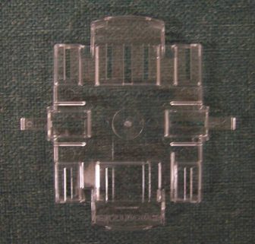
The Cause
Notes:
Presenter 1:
The dead-front safety shield was not re-installed in the disconnect adapter prior to resetting the meter.
________________
Duration = 30 secs
Total Elapsed = 6 mins

Slide 8
Turn to the person next to you. Spend a few minutes finding out their answer to this question. If this incident happened at your company, what Corrective Action would be taken, and what would the results be?
Question
Notes:
Presenter TWO asks this question, elicits responses, then reveals typical:
Corrective Action – punish technician for deliberately removing safety device.
Intended Result – hold him and others “accountable” for their decisions.
Presenter 1:
So that’s it.
Case closed, right?
Presenter TWO: “Well…” (advance slide)
________________
Duration = 6 mins
Total Elapsed = 12 mins

Slide 9
The Cause
Notes:
Presenter 1:
See, what MANY people call the “Cause” is really…
________________
Duration = 15 secs
Total Elapsed = 13 mins

Slide 10
The Cause Apparent
Notes:
Presenter 2:
…just the “Apparent Cause.”
So, what can you do to move
from the Apparent Cause
to the Root Cause?
Ask good questions.
________________
Duration = 15 secs
Total Elapsed = 13 mins

Slide 11
4-8 Questions
Turn to the person next to you.
Working together, write down 4-8 questions you realistically could and would ask in a Root Cause Analysis of this event.
Notes:
Both presenters monitor, listen, and coach individual pairs as needed.
________________
Duration = 5 mins
Total Elapsed = 18 mins

Slide 12
The Root Cause
What caused him to remove the shield?
Notes:
Presenter TWO asks:
What caused him to remove his shield… specifically…” (advance slide)
Presenter 1 answers in their own words based on details given in “Notes” section of first few slides.
________________
Duration = 30 secs
Total Elapsed = 19 mins

Slide 13
The Root Cause
What caused him to remove the shield?
Did someone tell him to remove it or did he do it on his own?
Notes:
Presenter TWO asks question (and asks how many audience members came up with same question)
Presenter 1 answers in their own words based on details given in “Notes” section of first few slides.
________________
Duration = 1 min
Total Elapsed = 20 mins

Slide 14
The Root Cause
What caused him to remove the shield?
Did someone tell him to remove it or did he do it on his own?
Did he remove it just this once or does he remove it every time?
Notes:
Presenter TWO asks question (and asks how many audience members came up with same question)
Presenter 1 answers in their own words based on details given in “Notes” section of first few slides.
________________
Duration = 1 min
Total Elapsed = 21 mins

Slide 15
The Root Cause
What caused him to remove the shield?
Did someone tell him to remove it or did he do it on his own?
Did he remove it just this once or does he remove it every time?
Did he make an error, or did he plan to remove it?
Notes:
Presenter TWO asks question (and asks how many audience members came up with same question)
Presenter 1 answers in their own words based on details given in “Notes” section of first few slides.
________________
Duration = 1 min
Total Elapsed = 22 mins

Slide 16
The Root Cause
What caused him to remove the shield?
Did someone tell him to remove it or did he do it on his own?
Did he remove it just this once or does he remove it every time?
Did he make an error, or did he plan to remove it?
Was the shield labeled as a safety device?
Notes:
Presenter TWO asks question (and asks how many audience members came up with same question)
Presenter 1 answers in their own words based on details given in “Notes” section of first few slides.
________________
Duration = 1 min
Total Elapsed = 23 mins

Slide 17
The Root Cause
What caused him to remove the shield?
Did someone tell him to remove it or did he do it on his own?
Did he remove it just this once or does he remove it every time?
Did he make an error, or did he plan to remove it?
Was the shield labeled as a safety device?
Was he trained or certified to do this procedure?
Notes:
Presenter TWO asks question (and asks how many audience members came up with same question)
Presenter 1 answers in their own words based on details given in “Notes” section of first few slides.
________________
Duration = 2 min
Total Elapsed = 25 mins

Slide 18
The Root Cause
What caused him to remove the shield?
Did someone tell him to remove it or did he do it on his own?
Did he remove it just this once or does he remove it every time?
Did he make an error, or did he plan to remove it?
Was the shield labeled as a safety device?
Was he trained or certified to do this procedure?
If we asked 10 other equivalently trained and experienced Linemen to do that job, would they also remove the shield? (substitution test)
Notes:
Presenter TWO asks question (and asks how many audience members came up with same question)
Presenter 1 answers in their own words based on details given in “Notes” section of first few slides.
________________
Duration = 2 min
Total Elapsed = 26 mins

Slide 19
The Root Cause
When instructors teach this procedure, do they point out how this shield works as a safety device?
Notes:
Presenter TWO asks question (and asks how many audience members came up with same question)
Presenter 1 answers in their own words based on details given in “Notes” section of first few slides.
________________
Duration = 3 min
Total Elapsed = 29 mins

Slide 20
 | Apparent Cause | Root Cause
Cause
Corrective Action
Result
Notes:
Ok, so let’s tally up the results.”
________________
Duration = 15 secs
Total Elapsed = 29 mins

Slide 21
 | Apparent Cause | Root Cause
Cause | Lineman violated procedure
Corrective Action | Punish lineman for violation
Result
Notes:
“If we stop at the Apparent Cause, we’ll wind up believing that the Lineman violated a safety procedure and probably should be punished for it.”
________________
Duration = 15 secs
Total Elapsed = 30 mins

Slide 22
 | Apparent Cause | Root Cause
Cause | Lineman violated procedure
Corrective Action | Punish lineman for violation
Result | Lineman decides that his company prizes “accountability” over solutions, and tells story of this unfairness until he retires. Incident occurs again.
Notes:
(just read text in box?)
________________
Duration = 1 min
Total Elapsed = 31 mins

Slide 23
 | Apparent Cause | Root Cause
Cause | Lineman violated procedure | Training did not include critical info.
Corrective Action | Punish lineman for violation
Result | Lineman decides that his company prizes “accountability” over solutions, and tells story of this unfairness until he retires. Incident occurs again.
Notes:
So when we stop asking, “WHO is at fault?” and start asking, “What’s the real cause?” then we find a weakness in our training program.
________________
Duration = 15 secs
Total Elapsed = 31 mins

Slide 24
 | Apparent Cause | Root Cause
Cause | Lineman violated procedure | Training did not include critical info.
Corrective Action | Punish lineman for violation | Update the training. Send bulletin to local offices.
Result | Lineman decides that his company prizes “accountability” over solutions, and tells story of this unfairness until he retires. Incident occurs again.
Notes:
The solution is relatively inexpensive, and simple.
________________
Duration = 15 secs
Total Elapsed = 31 mins

Slide 25
 | Apparent Cause | Root Cause
Cause | Lineman violated procedure | Training did not include critical info.
Corrective Action | Punish lineman for violation | Update the training. Send bulletin to local offices.
Result | Lineman decides that his company prizes “accountability” over solutions, and tells story of this unfairness until he retires. Incident occurs again. | Incident doesn’t reoccur for many years if ever. Lineman and other employees see their company solve a problem with reason instead of power.
Notes:
But most importantly, the solution actually works.”
Ask audience what’s going through their mind about this case right now?
________________
Duration = 3 secs
Total Elapsed = 34 mins

Slide 26
Two Brief
Teaching
Cases
James Merlo, NERC
& Jake Mazulewicz,
Dominion VA Power
__________________________
NERC Human Performance Conference
March 2013
Notes:
This slide is just a“chapter marker – to help participants cognitively “chunk” the two cases more effectively.

Slide 27
The Second Event
Notes:
Presenter 1:
At 3:26 in the afternoon, on a hot spring day, lightning struck a 138 kV transmission line.
Breakers on that line opened instantly.
Simultaneously, an unexpected breaker failure lockout caused SIX other breakers to open.
This caused outages to two additional transmission lines, plus a 138kV bus and a 345/138kV transformer bank.
Total - over 8,000 people in the dark
________________
Duration = 3 mins
Total Elapsed = 3 mins

Slide 28
The Cause
Notes:
The protection system failed to operate as desired because a single set of jumpers was left in place.
The jumper position did not allow the breaker failure timer to operate, so the breaker went into lockout mode and tripped the six other breakers open.
________________
Duration = 2 mins
Total Elapsed = 5 mins

Slide 29
Turn to the person next to you. Spend a few minutes finding out their answer to this question. If this incident happened at your company, what Corrective Action would be taken, and what would the results be?
Question
Notes:
Both presenters monitor, listen, and coach individual pairs as needed.
________________
Duration = 4 mins
Total Elapsed = 9 mins

Slide 30
The Cause
Notes:
Presenter 1:
By now you know that, what MANY people call the “Cause” is really… (elicit)
________________
Duration = 15 secs
Total Elapsed = 9 mins

Slide 31
The Cause
Apparent
Notes:
Presenter 2:
…just the “Apparent Cause.”
So, what can you do to move
from the Apparent Cause
to the Root Cause?
Ask good questions.
________________
Duration = 30 secs
Total Elapsed = 10 mins

Slide 32
4-8 Questions
Turn to the person next to you.
Working together, write down 4-8 questions you realistically could and would ask in a Root Cause Analysis of this event.
Notes:
Both presenters monitor, listen, and coach individual pairs as needed.
________________
Duration = 5 mins
Total Elapsed = 15 mins

Slide 33
The Root Cause
What led him to leave the jumper in place?
Notes:
Presenter TWO asks:
What caused him to leave the jumpers in place… specifically…” (advance slide)
________________
Duration = 15 secs
Total Elapsed = 16 mins

Slide 34
The Root Cause
What led him to leave the jumper in place?
Did he use any defenses to remind himself to remove the leads?
Notes:
Presenter TWO asks question (and asks how many audience members came up with same question)
Presenter 1 answers – “None that we know of. “
Good follow up questions might be,
“What defenses do you use in situations like these?”
“What defended COULD you use?”
________________
Duration = 2 mins
Total Elapsed = 18 mins

Slide 35
The Root Cause
What led him to leave the jumper in place?
Did he use any defenses to remind himself to remove the leads?
Did he do anything different this time vs. previous times when he’s done this job?
Notes:
Presenter TWO asks question (and asks how many audience members came up with same question)
Presenter 1 answers – “Nothing that we know of. “
This is a good time to ask relevant follow up questions.
________________
Duration = 2 mins
Total Elapsed = 20 mins

Slide 36
The Root Cause
What led him to leave the jumper in place?
Did he use any defenses to remind himself to remove the leads?
Did he do anything different this time vs. previous times when he’s done this job?
Was he trained or certified to do this procedure?
Notes:
Presenter TWO asks question (and asks how many audience members came up with same question)
Presenter 1 answers – “Yes.”
This is a good time to ask relevant follow up questions like, “Does the training at your company include human performance defenses that would apply here? Have you worked with other companies who used significantly better HP defenses in jobs like this?... Or others who didn’t use any HP defenses in jobs like this? – no need to reveal names, just stories.”
________________
Duration = 3 mins
Total Elapsed = 23 mins

Slide 37
The Root Cause
What led him to leave the jumper in place?
Did he use any defenses to remind himself to remove the leads?
Did he do anything different this time vs. previous times when he’s done this job?
Was he trained or certified to do this procedure?
Were the correct leads identified on the print?
Notes:
Presenter TWO asks question (and asks how many audience members came up with same question)
Presenter 1 answers – The field technician installed the relay and wiring according to the supplied wiring diagram. The wiring diagram had an incorrect jumper position as compared to the logic diagram used in the design phase of the project. The jumper was only required during the initial installation. After the final installation work was complete, the jumper should have been removed, however, the jumper was left in the field prints. The operator left the jumper in place per the diagram (predictable and seemingly appropriate behavior). Prior work on the relay included a plan to change how breaker failure operated for breakers A, D, and E. The jumper change (or removal in this case) was not included on the wiring diagram used for the field installation of the relay.
GREAT opportunity to talk about JUST CULTURE in the company. Will people admit to making an error? Is management going to support people talking about weaknesses in the company?
This is a good time to ask relevant follow up questions like, “Have you ever experienced something like this? Without revealing names, or other identifying details, can you tell us the story of what happened?”
________________
Duration = 4 mins
Total Elapsed = 27 mins

Slide 38
The Root Cause
What led him to leave the jumper in place?
Did he use any defenses to remind himself to remove the leads?
Did he do anything different this time vs. previous times when he’s done this job?
Was he trained or certified to do this procedure?
Were the correct leads identified on the print?
If we asked 10 other equivalently trained and experienced field technicians to do that job, would they also forget to remove the leads? (substitution test)
Notes:
Presenter TWO asks question (and asks how many audience members came up with same question)
Presenter 1 answers – probably many others would have done the same thing. So what started out looking like an individual error, we now can see is clearly a latent error (or condition).
________________
Duration = 3 mins
Total Elapsed = 30 mins

Slide 39
 | Apparent Cause | Root Cause
Cause | Field Technician left jumper in place
Corrective Action | Punish Field Technician for violation
Result
Notes:
Presenter 1 – “So let’s do the summary.”
________________
Duration = 1 min
Total Elapsed = 31 mins

Slide 40
 | Apparent Cause | Root Cause
Cause | Field Technician left jumper in place
Corrective Action | Punish Field Technician for violation
Result | Incident occurs again. Field Technician can’t understand how he made this error, (and retells story for years).
Notes:
Presenter 1
________________
Duration = 1 min
Total Elapsed = 32 mins

Slide 41
 | Apparent Cause | Root Cause
Cause | Field Technician left jumper in place | Wiring and logic diagrams were different. No organizational process to verify wiring diagrams and prints.
Corrective Action | Punish Field Technician for violation
Result | Incident occurs again. Field Technician can’t understand how he made this error, (and retells story for years).
Notes:
Presenter TWO
________________
Duration = 1 min
Total Elapsed = 33 mins

Slide 42
 | Apparent Cause | Root Cause
Cause | Field Technician left jumper in place | Wiring and logic diagrams were different. No organizational process to verify wiring diagrams and prints.
Corrective Action | Punish Field Technician for violation | Create process to verify wiring diagrams.
Result | Incident occurs again. Field Technician can’t understand how he made this error, (and retells story for years).
Notes:
Presenter TWO
________________
Duration = 1 min
Total Elapsed = 34 mins

Slide 43
 | Apparent Cause | Root Cause
Cause | Field Technician left jumper in place | Wiring and logic diagrams were different. No organizational process to verify wiring diagrams and prints.
Corrective Action | Punish Field Technician for violation | Create process to verify wiring diagrams.
Result | Incident occurs again. Field Technician can’t understand how he made this error, (and retells story for years). | Check of wiring diagrams reveals two more latent errors in the system that could easily have led to incidents had they not been found.
Notes:
Presenter TWO
Having a culture
________________
Duration = 2 min
Total Elapsed = 35 mins

Slide 44
Two Brief
Teaching
Cases
James Merlo, NERC
& Jake Mazulewicz,
Dominion VA Power
__________________________
NERC Human Performance Conference
March 2013

